Slide 1
Risk and Uncertainty in
Building Portfolio Decarbonization
Macroeconomic Scenarios,
Capital Costs, and Carbon Emissions
Professor Michael Robbins
Runmu Yue, Yixuan Chen, Emily Cai, Yiyi Jiang, Yu Yang
April 28, 2023

Slide 2

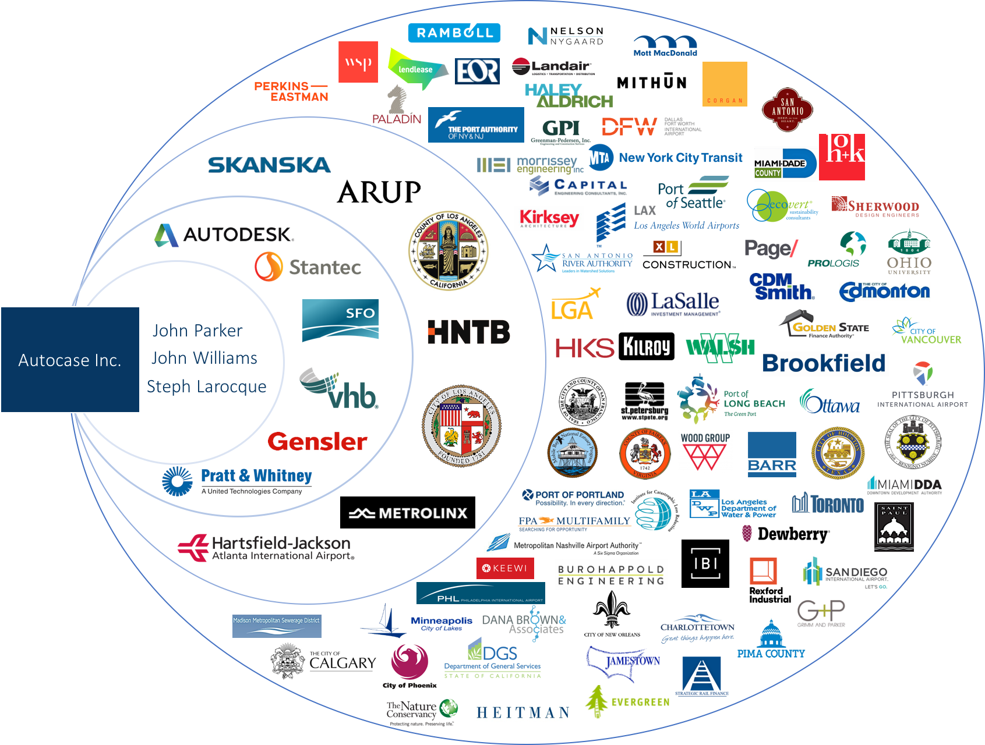
Our Group and Employer
SaaS and consulting firm
Economic analyses of building and site infrastructure projects
Autocase is our cloud-based sustainable economic analysis tool
Shane Minckley
Senior Economist & Implementation Manager

Slide 3
Life Cycle Cost Analysis (LCCA)
Why does Life Cycle Cost Analysis matter?
LCCA provides decision-makers with a comprehensive and accurate view of the total cost of owning, operating, and disposing of a product or asset over its entire life cycle. LCCA matters because it enables decision makers to consider their total cost of ownership, as well as other effects like carbon emissions, and make more optimal decisions
LCCA indicators
Net Savings = Total Savings - Total Cost
Savings to Investment Ratio = Total Savings / Total Cost
Simple Payback Period = Upfront Capital Cost / Annual Savings
Discounted Payback Period = Upfront Capital Cost / [Annual Savings * (1+Discount Rate)]

Slide 4
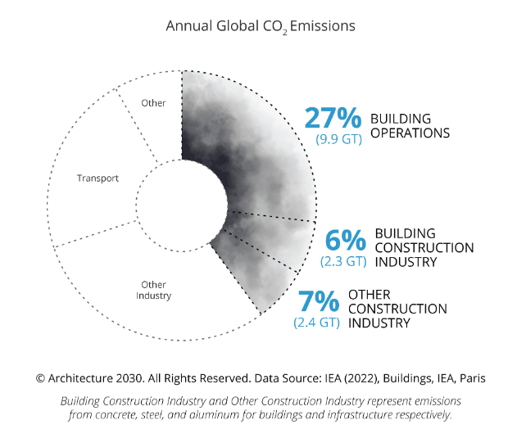
Lifecycle Cost and Carbon Emissions
Why does building decarbonization matter?
Buildings represent 40% of global carbon emissions
Leveraging scenario forecasts provided by the EIA, we can take United States based building portfolios and perform simulation to evaluate their exposure to both utility cost and grid emissions changes through time and their likelihood of hitting their decarbonization targets.
Notes:
Building portfolios are exposed to many dimensions of risk, our initial set of considerations includes both utility cost and grid emissions changes through time
Leveraging scenario forecasts provided by the EIA, we can take United States based building portfolios and evaluate their exposure to changes in these two major input variables in terms of their capital budgets for decarbonization and their likelihood of hitting their stated decarbonization carbon targets

Slide 5
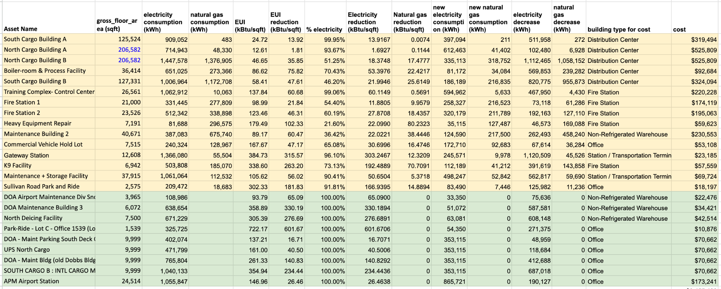

Dataset : Building Portfolio Data
Building Portfolio Data
Data source: building portfolio data is provided by Autocase from a project for Atlantic Airport
It includes some fundamental information such as natural gas/electricity savings and rent/investment of 24 assets.
Notes:
before we jump into the simulation details, let's take a quick look at our data set, which is divided into three parts. The first part is the building portfolio data, which is the most fundamental part of our data set. This data was obtained from a project that was carried out for Atlantic Airport by Autocase. It contains essential and realistic information for 23 assets, including emission data such as annual electricity and gas decrease amounts, as well as financial data like building investments.
#All of this information is crucial in predicting whether a specific building will achieve its financial or environmental targets in the near future.

Slide 6
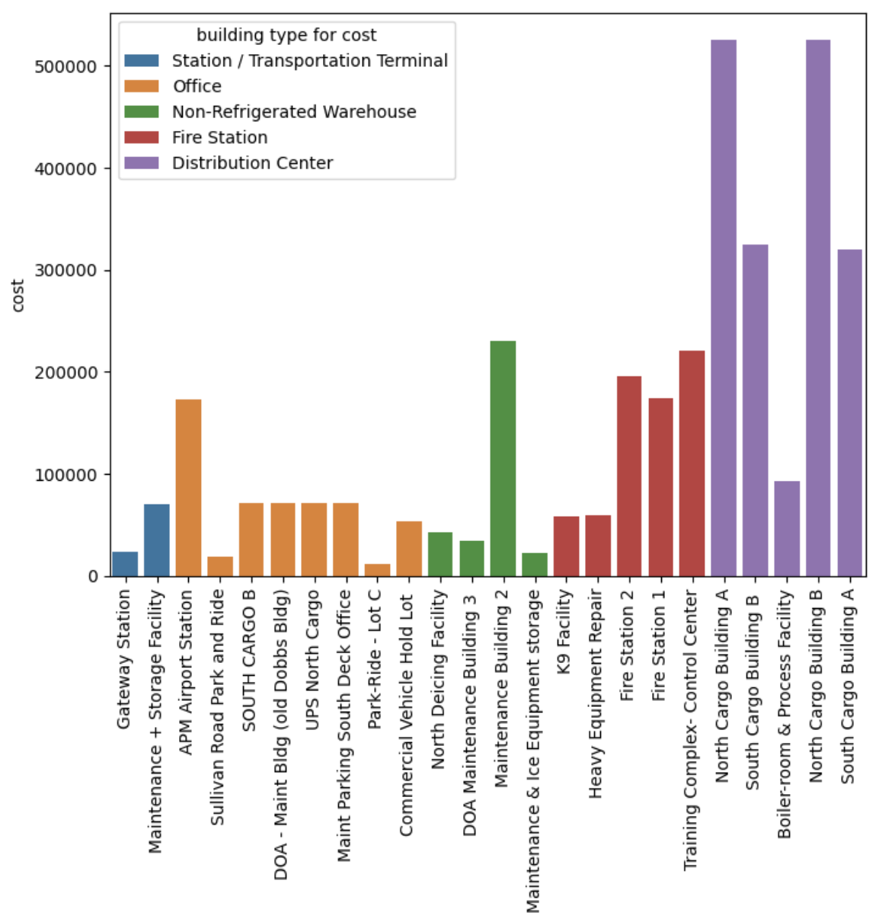
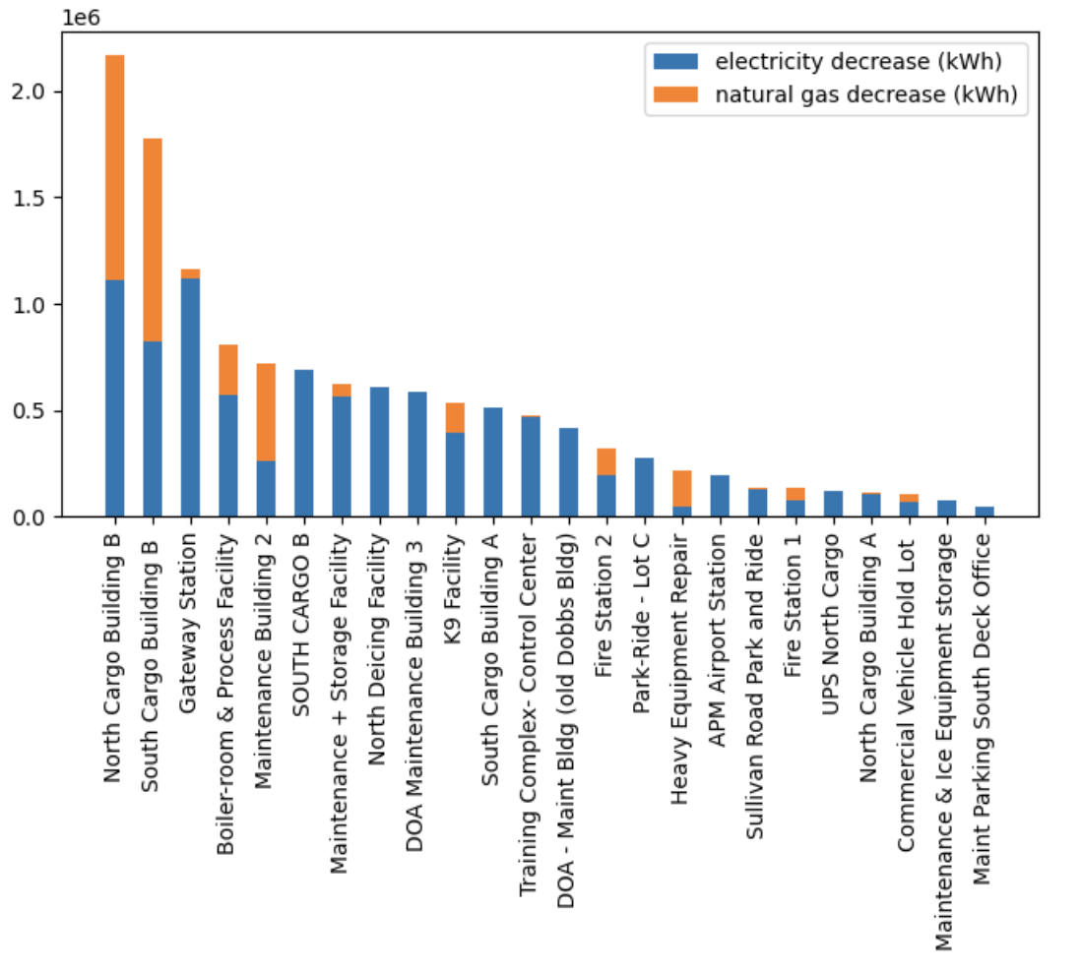

Dataset : Building Portfolio Data
Building Portfolio Data
Building cost = gross floor area * cost per square foot；High cost of distribution center is caused by large floor area
Emission reduction more dependent on electricity than natural gas
9 assets have no gas decrease, warehouses or offices
Notes:
Now, let's take a closer look at the portfolio data on this slide. When calculating the cost of a building, we multiply its gross floor area by the cost per square foot. This means that buildings with larger floor areas tend to have higher costs. On the left-hand side of the slide, you can see a graph that shows the distribution of asset costs. The graph indicates that distribution centers often have high costs due to their large floor areas.
Moving on to the second graph, which shows the annual electricity and gas reduction for each building. Emission reduction more dependent on electricity than natural gas, there are even 9 assets that have zero gas reduction, they are warehouses or offices.

Slide 7
Dataset : Utility Rate and Emission Factor
How do utility rate and emission factor connect to LCCA and greenhouse gas emission targets?
Utility Rate: per unit of energy monetary costs, $/kWh
Emission factor: per unit of energy pollutant emissions, MTCO2/kWh
Utility and emission factor they together decide whether client can make their financial and environmental target
Both are dynamic, varying with macroeconomic factors
Metric Type | Indicator | Formula
LCCA | Net Saving | total cost - (energy reduction volume*energy price)
LCCA | Simple Payback Period | total cost/ (annual energy reduction volume*energy price)
LCCA | Discounted Payback Period | total cost / (annual energy reduction volume*energy price*(1+discount rate))
LCCA | Savings-to-investment Ratio | (energy reduction volume*energy price) / investment
Greenhouse Gas Emission | Carbon Dioxide Equivalent | energy consumption*( emission volume/energy generation )
Notes:
Here we come to the second data set, utility rate and emission factor. This part is more about some definition and calculation.
The utility rate is the cost per unit of energy consumed, typically measured in $/kWh.
The emission factor represents the amount of pollutants emitted per unit of energy consumed, measured in MTCO2/kWh.
It's important to note that the underlined items, energy price, and emission volume, the fundamental elements of the utility rate and emission factor. However, they are dynamic and can vary based on macroeconomic factors such as changes in fuel prices, regulations, and technology.

Slide 8
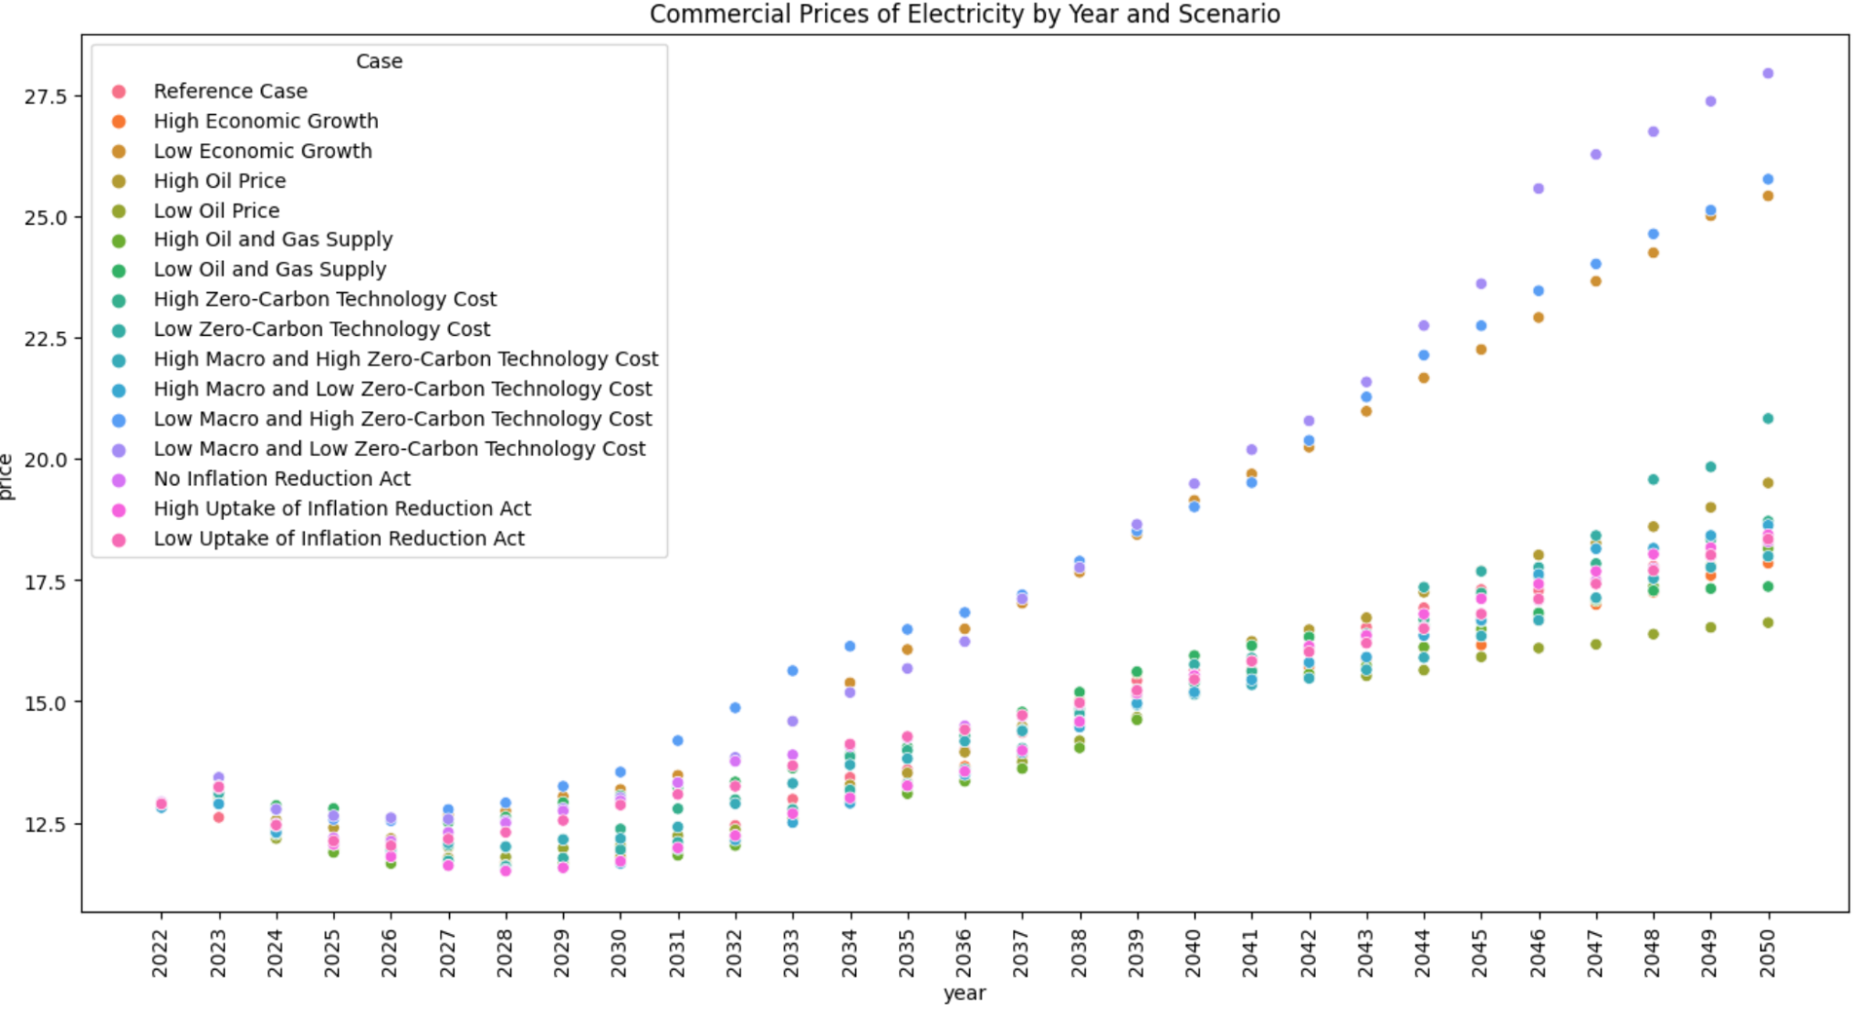
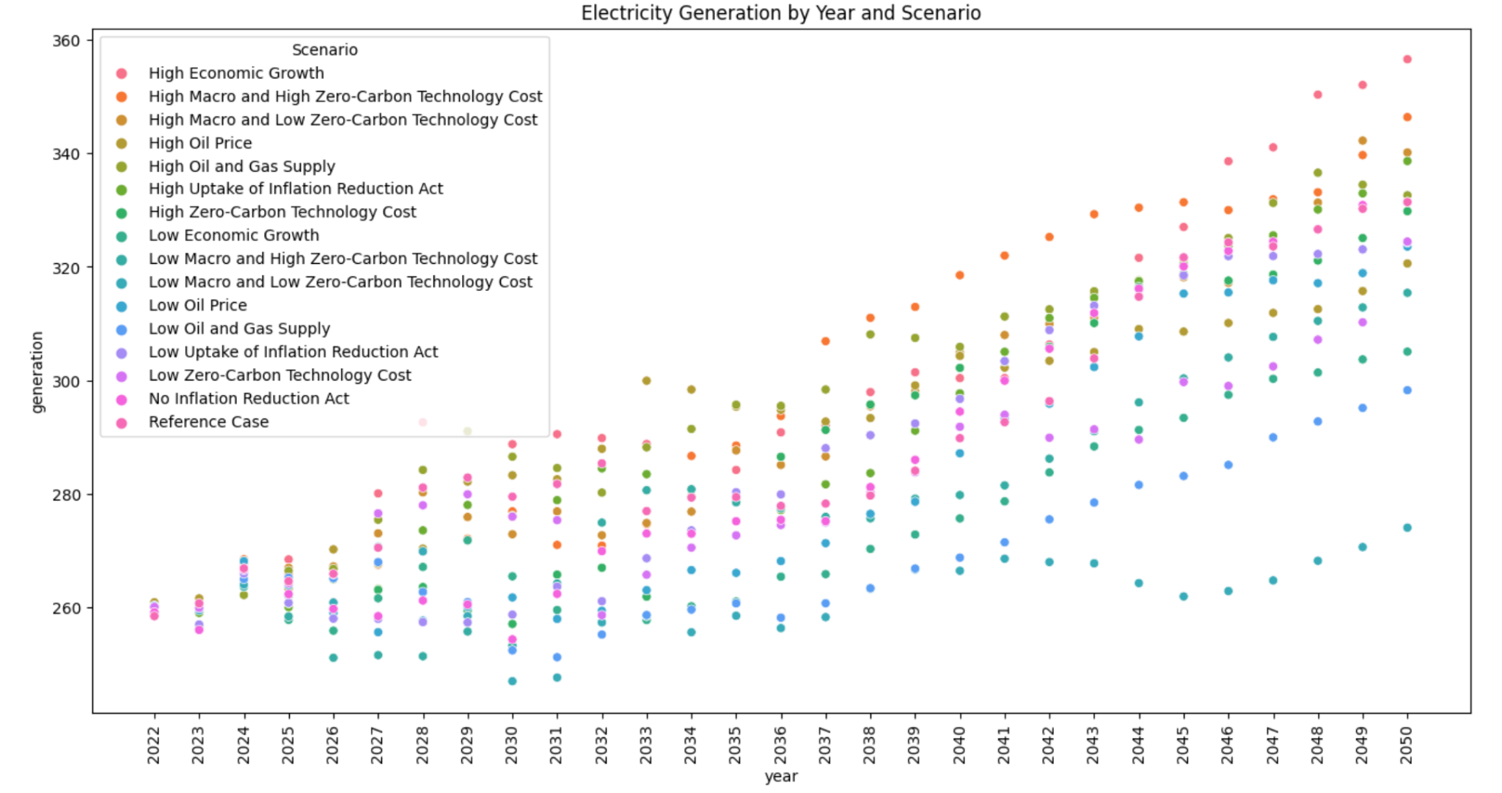
Dataset : Scenario Data and Macroeconomic Fatcors
How can we deal with uncertainty in future utility rates and emission factors?
Data Source: U.S. Energy Information Administration (EIA), a government agency providing energy data
EIA summarizes the macroeconomic situation into 16 scenarios and predicts energy data for each scenario for the following 30 years.
The energy data predictions from the EIA we used are energy generation and price for electricity and natural gas, which are varying with time and scenario
Notes:
To account for the these changes, it is important to simulate the utility rates and emission factors to better understand their impact on building financial and environmental performance.
our data source for simulation is the U.S. Energy Information Administration (EIA).
The EIA is a government agency that provides all kinds of energy data.
To help users better understand the range of possible macroeconomic scenarios, the EIA summarizes all situation into 16 scenarios and predicts the energy volume and energy price in each scenario for the following 30 years.
With data from EIA, these two graphs show how energy volume and price change over time and in different scenarios in the future .We can also get some interesting facts form these two graphs ,in years with low oil price scenario, energy prices tend to be lower, while in high oil price years, energy costs tend to be higher. This pattern follows our intuition that energy prices are affected by oil prices.

Slide 9
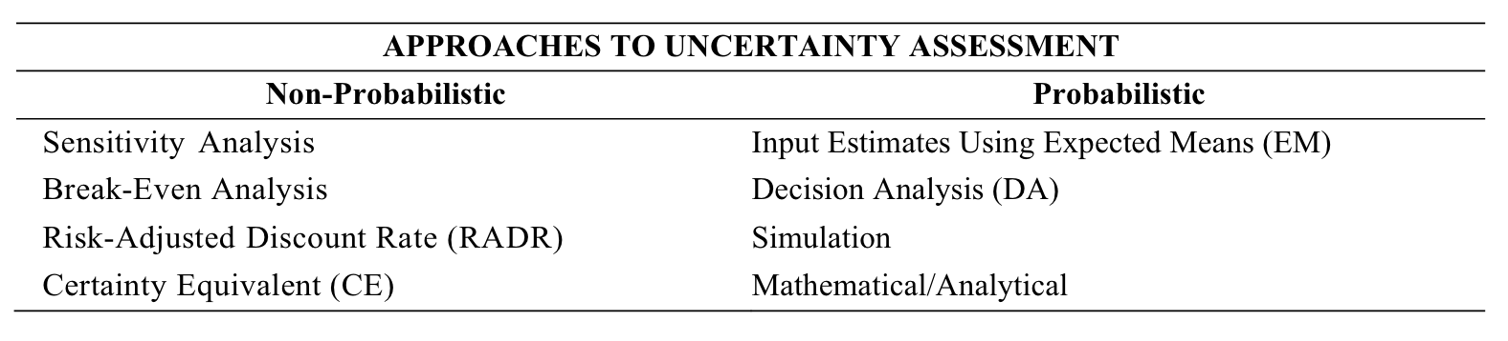
Simulation Concept
There are two types of uncertainty assessment techniques: Non-probabilistic & Probabilistic
Probabilistic assessment provides a more complete consideration of the uncertainty in inputs
We use Monte Carlo Simulation based on scenario data to analyse uncertainty
Notes:
The 16 scenarios shows the uncertainty in future, and there are two types of uncertainty assessment techniques to deal with it
The first type is non-probabilistic methods including sensitivity analysis, break-even analysis etc
The second is probabilistic methods, which provides a more complete consideration of the inputs uncertainty
In the following part , we will focus on using the Monte Carlo Simulation for building decarbonization analysis

Slide 10
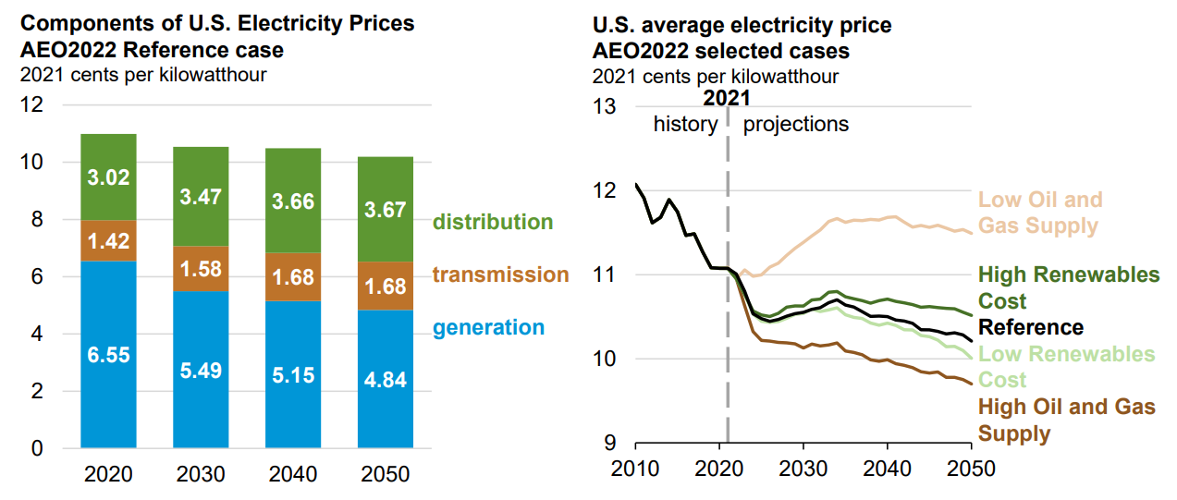
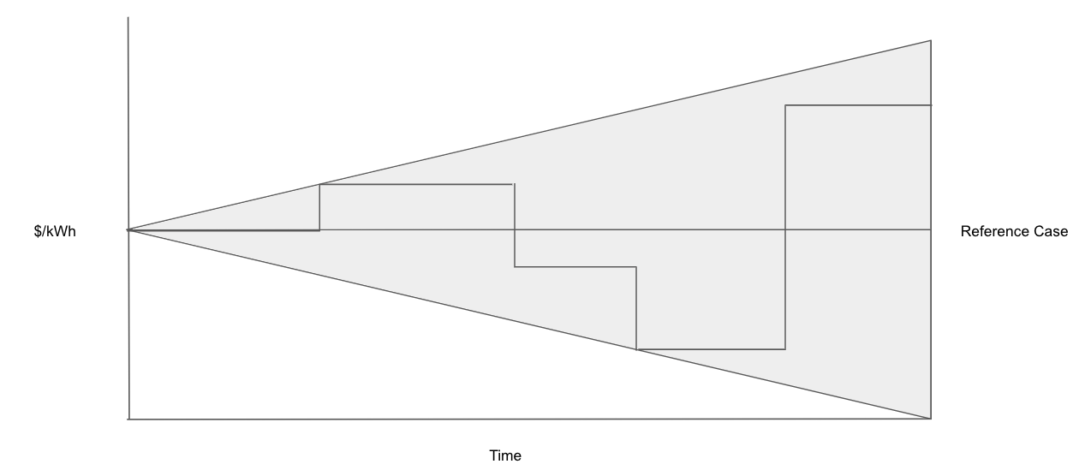
Simulation Concept
There are two types of uncertainty assessment techniques: Non-probabilistic & Probabilistic
Probabilistic assessment provides a more complete consideration of the uncertainty in inputs
We use Monte Carlo Simulation based on scenario data to analyse uncertainty
Notes:
The basic idea is, instead of using the deterministic scenario projections, we treat them as probabilistic
For each uncertain variables, we sample within the range for all 30 years, and use the simulate paths to compute final result

Slide 11
Simulation Framework
Determine the annually min-to-max range based on scenario forecast
Sample uniformly from the min-to-max range to generate pathway
Smooth the pathway by constraining the possible maximum jump
Repeat the simulation process to represent the area
Notes:
Specifically,

Slide 12
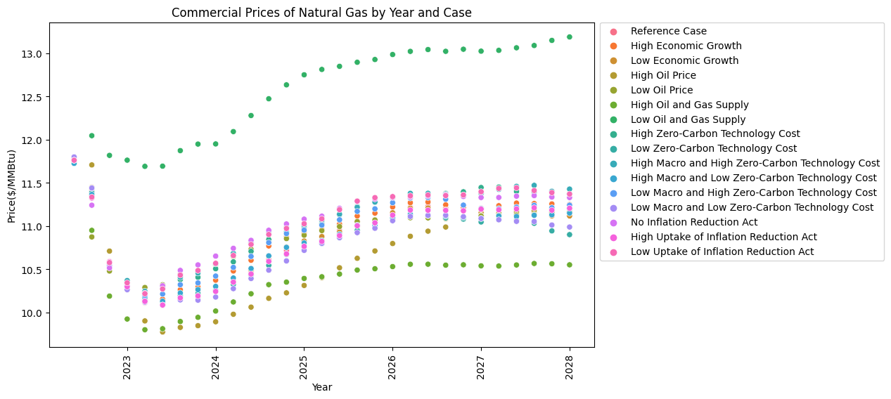
Simulation Framework
Scenario Forecasts
Determine the annual min-to-max range
Find the maximum jump between two years in one scenario
Maximum jump

Slide 13
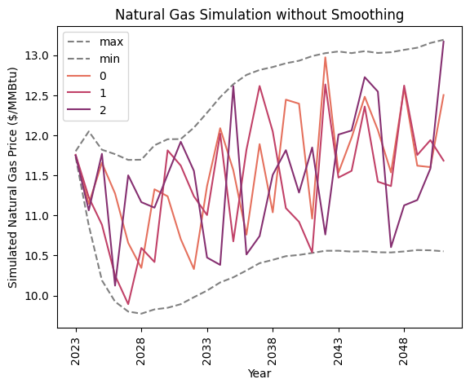
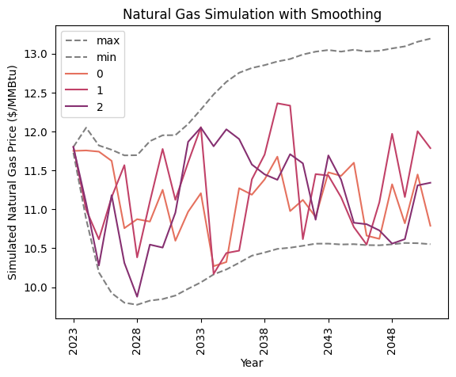
Simulation Framework
Simulation
For each year, sample uniformly from the annual range to generate pathway
Smooth the pathway by constraining the possible maximum jumps between two consecutive years

Slide 14
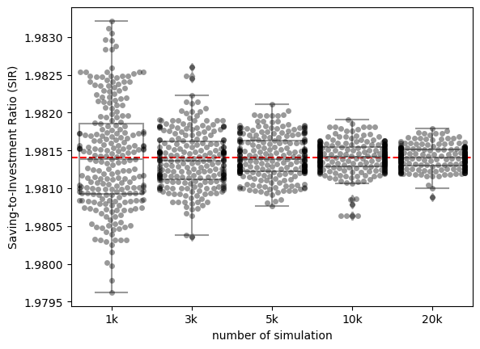
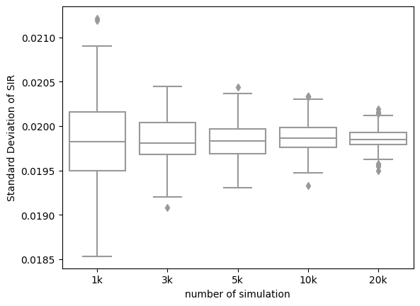
How Many Simulations for Consistent Results?
We experiment with simulation counts from 1k to 20k, and repeat each count 240 times (24 buildings with 10 iterations each)
For LCCA metrics, we use Saving-to-Investment (SIR) ratio as output
5k simulations provides good reliable with relatively low computational power required
Notes:
We experiment with simulation counts from 1k to 20k, and repeat each count 240 times (24 buildings with 10 iterations each)
For LCCA metrics, we use Saving-to-Investment (SIR) ratio as output
We pick one building to run the experiment.
As shown in the boxplots, each bucket represent the simulation counts. The left shows the mean while the right shows the std
We find 5k simulations provides reliable result with relatively low computational power required

Slide 15
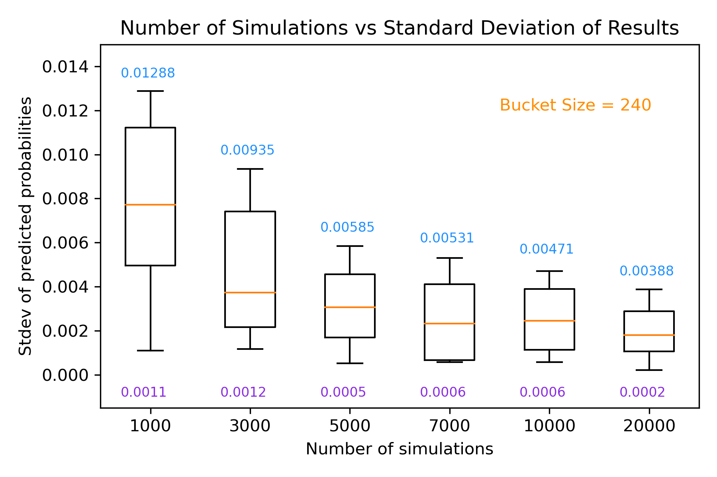
How Many Simulations for Consistent Results?
We experiment with simulation numbers from 1k to 20k, and repeat each number 240 times (24 buildings with 10 iterations each)
For Greenhouse gas emission, we output the probability of reducing x% of our emissions by 2050.
5k simulations provides good reliable with relatively low computational power required

Slide 16
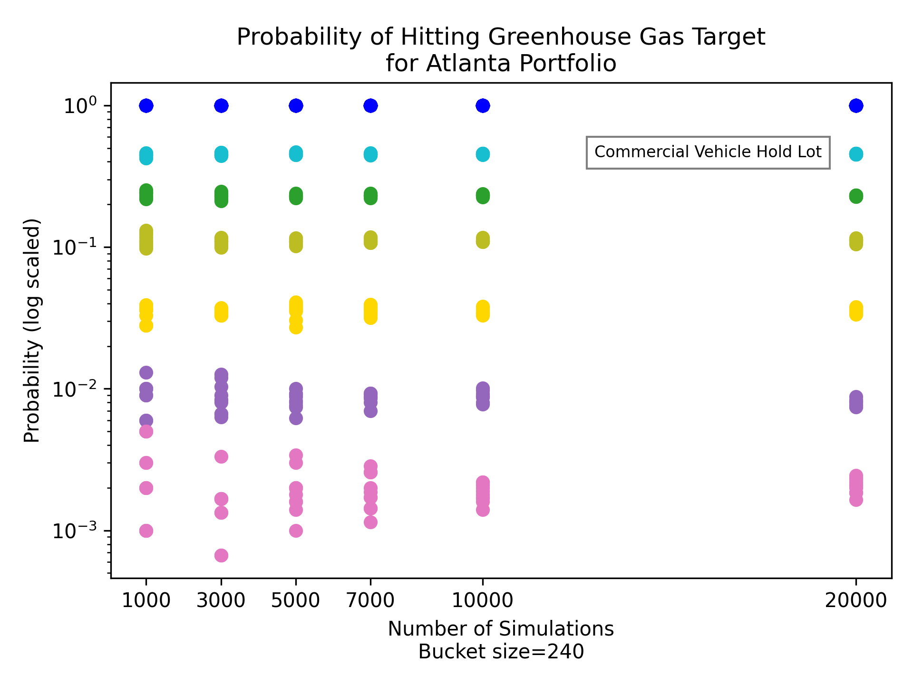
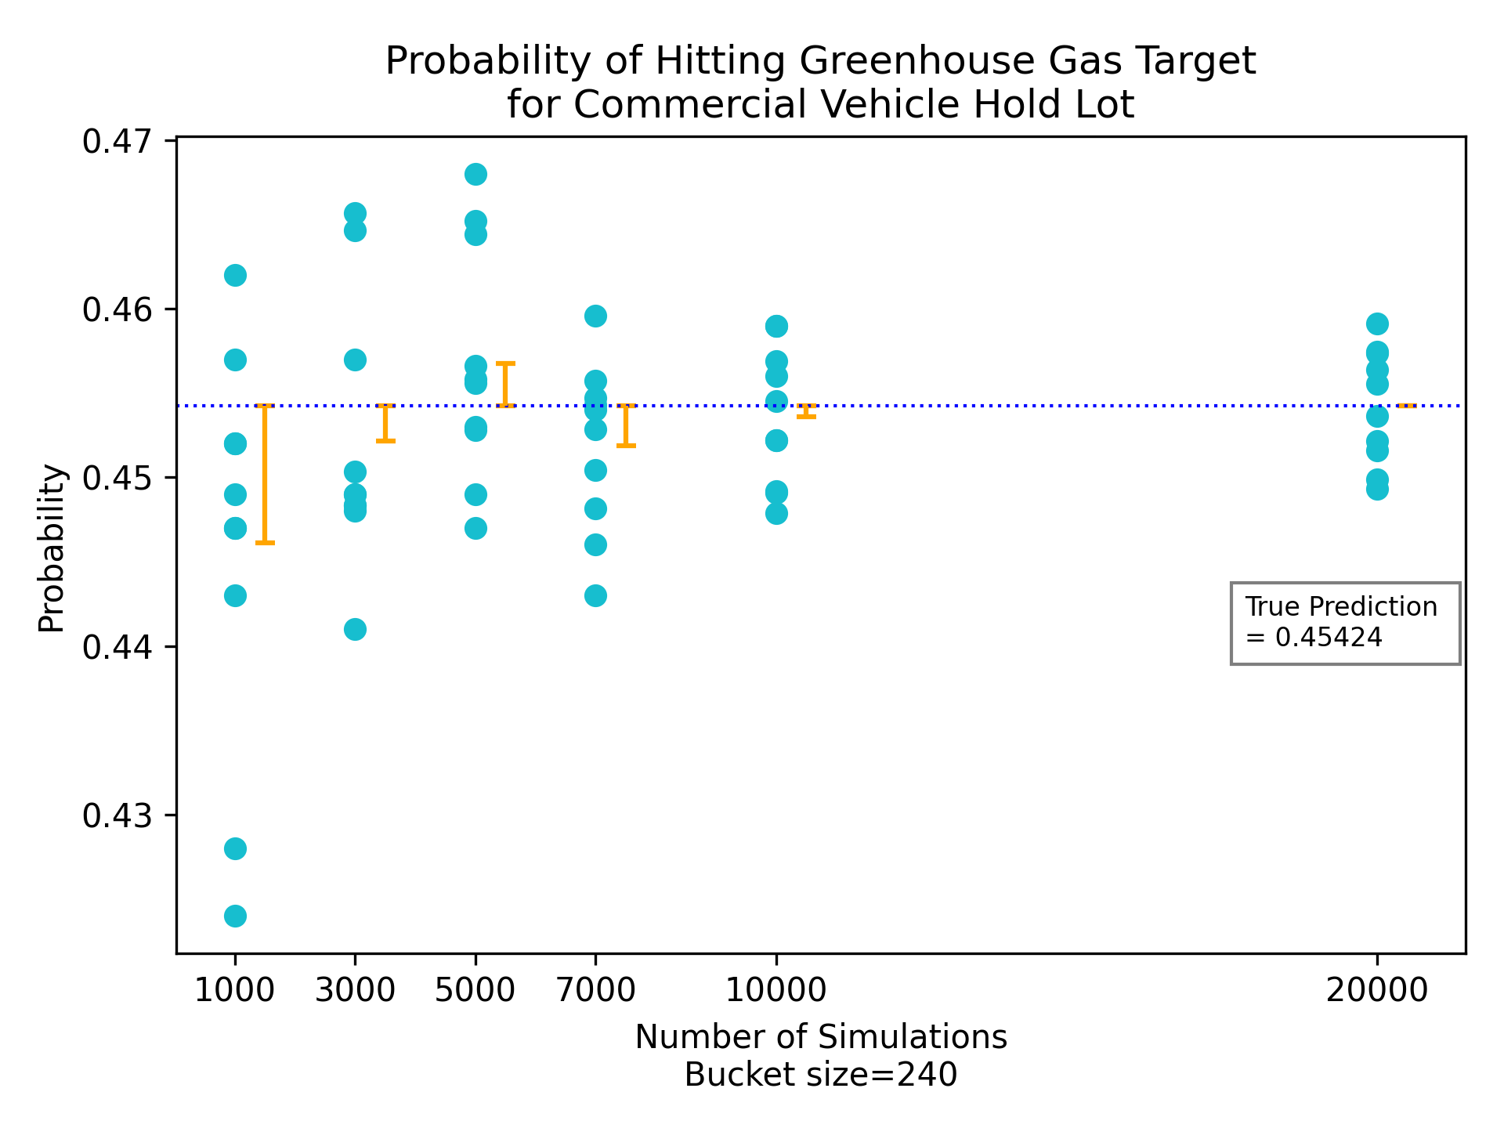
How Many Simulations for Consistent Results?
The average from 5k simulations is a good estimate for the average from 20k simulations, our true prediction.
We eliminate 3k from consideration after observing its large spread for the buildings in pink and purple.
Every color represents a different building

Slide 17
Project Example Outcome
LCCA benchmark in practice
Simple Payback Period < 7 (years)
Saving-to-Investment Ratio > 2
Asset Name | Electricity Decrease (kWh) | Natural Gas Decrease (kWh) | Cost | Net Saving | Simple Payback Period | Discounted Payback Period | Saving-to-Investment Ratio | Decision
South Cargo Building A | 511,958 | 272 | $319,494 | 1,150,228 | 4.17 | 5.0 | 4.6 | Accept
North Cargo Building A | 102,480 | 6,928 | $525,809 | -216,448 | 32.48 | 33.45 | 0.59 | Reject
Fire Station 1 | 73,118 | 61,286 | $174,119 | 170,892 | 10.33 | 10.99 | 1.98 | Reject
Notes:
For LCCA, we generate 5000 simulated electricity prices and natural gas prices, combined them with building data to calculate the LCCA output
As for evaluation, we refer to some benchmarks in practice: SPP should be less than 7 years, and SIR should be greater than 2
The table shows the outcome of 3 buildings, among which we should accept the investment on the first one, and reject the 2nd and 3rd according to our standard.

Slide 18

User Interface for LCCA Indicators
Portfolio Testing
User select the buildings they want to use to build their portfolio
Output the four LCCA indicators based on the selections
Calculations take all the buildings in the portfolio as one “giant building” (add up their electricity decrease, gas decrease, and cost together)

Slide 19
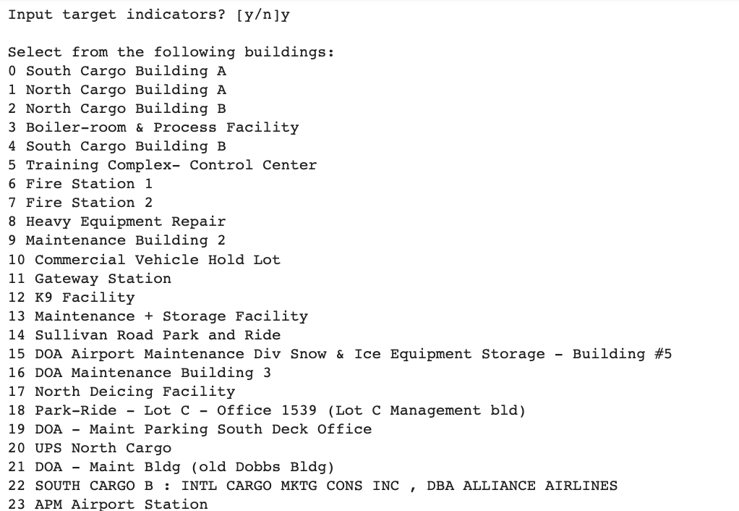
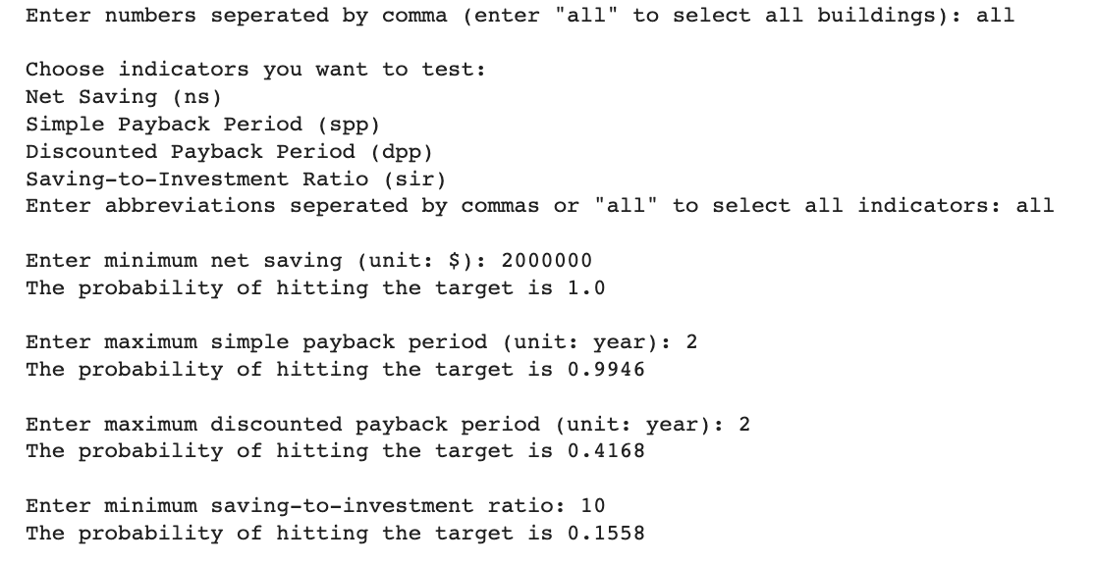
User Interface for LCCA Indicators
Probability of Hitting Indicator Targets
User select the buildings in their portfolio
User input their desired indicator targets
Run simulations based on the selected buildings, then calculate the proportion of the simulation results that meet the user targets

Slide 20

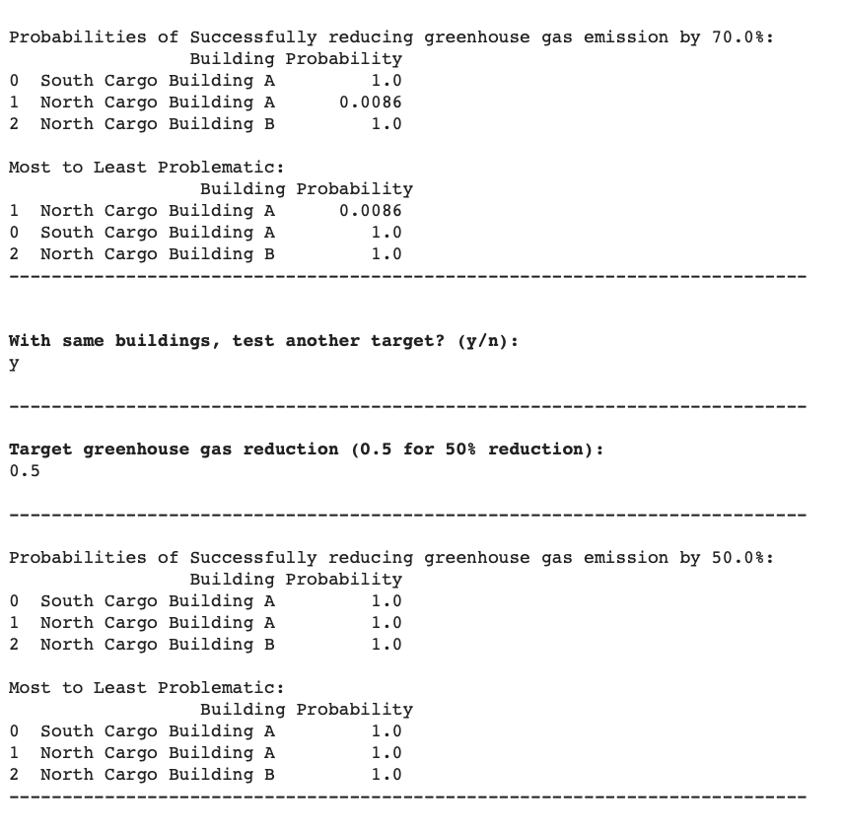
User Interface for Greenhouse Gas Emissions
Notes:
The interface for greenhouse gas emissions takes 2 user inputs: the set of buildings they would like to consider and the target reduction rate by year 2050.
Then, the interface gives a success probability for every building, and brings the problematic ones to the user’s attention.

Slide 21
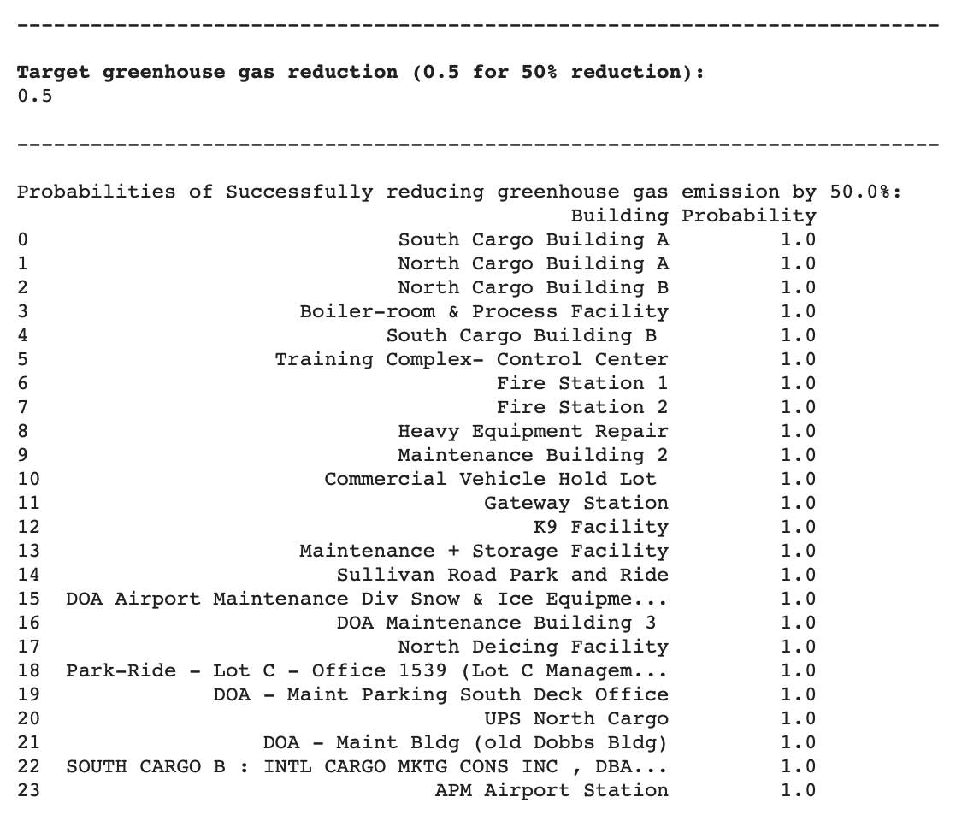
User Interface for Greenhouse Gas Emissions
Probability of Hitting Greenhouse Gas Target
We project that our entire Atlanta portfolio can reduce 50% of its greenhouse gas emission by 2050.
In fact, this prediction holds up to 61%.
These projections become important for customers once they meet their LCCA indicator targets.

Slide 22
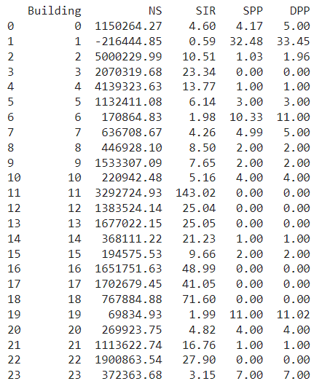
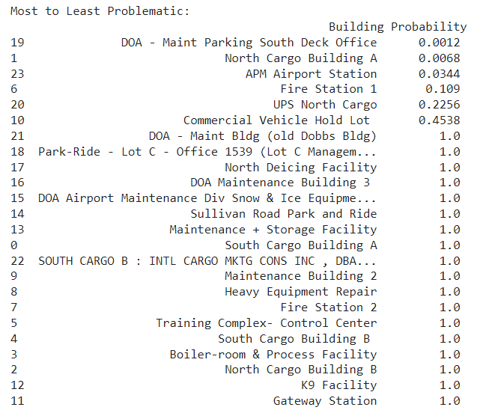
Results and Suggestions
Notes:
We generate the results for all our 24 buildings in our portfolio using our interface. Based on our benchmark, only 3 buildings have saving-to-investment ratio smaller than 2 and 3 have the payback period greater than 7. With the target of reducing the carbon emission for 70%, only 7 are failed to meet the target.

Slide 23
Thank you for your time!
Questions?

